Slide 1
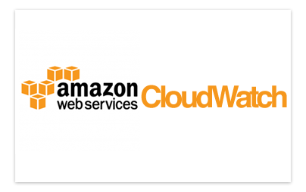

Slide 2

Topics
What is Cloud Watch?
Metric Level

Slide 3

What is Cloud Watch?
Amazon CloudWatch is a monitoring service for AWS cloud resources and the applications you run on AWS.
You can use Amazon CloudWatch to collect and track metrics, collect and monitor log files, and set alarms

Slide 4

Can Monitor
Compute:
EC2 Instance
Autoscaling Group
Elastic Load Balance
Route53 health check
Storage & Content Delivery
EBS volume
Storage Gateway
CloudFront

Slide 5

Host Level Metric Consist of:
CPU
Network
Disk
Status Check

Slide 6

What is Cloud Trail?
CloudTrail provides visibility into user activity by recording actions taken on your account.
You can identify which users and accounts called AWS, the source IP address from which the call were made and when the calls occurred.

Slide 7

What is Cloud Trail?
CloudTrail records important information about each action, including who made the request, the services used, the actions performed, parameters for the actions, and the response elements returned by the AWS service

Slide 8
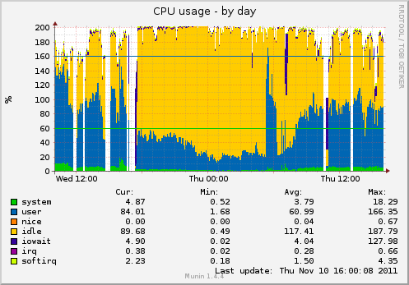

CloudWatch vs CloudTrail?
CloudWatch monitors performance
CloudTrail monitors API calls in the AWS platform

Slide 9
Point to remember
CloudWatch is used for monitoring performance
CloudWatch can monitor most of AWS as well as your applications that run on AWS
CloudWatch with EC2 will monitor events every 5 minutes by default.
You can have 1-minute intervals by turning on detailed monitoring
You can create CloudWatch alarms which trigger notifications
CloudWatch is all about performance. CloudTrail is all about auditing

Slide 10
Thank you

